Slide 1

Search Engine Assignment
Understanding and Implementing Document Search

Slide 2

Objective
Implement
Implement a Python-based Search Engine.
Handle
Handle user queries effectively with error tolerance.
Provide
Provide accurate document rankings based on query relevance.

Slide 3

Goal
To make A Web Based App which Implements Searching throw documents.
Enhance understanding of core concepts in Information Retrieval.

Slide 4
Installation Guide
1. Clone the repository
2. Create a virtual environment and install dependencies
3. Run the server using:
python manage.py runserver

Slide 5
Technologies Used
Python, Django
Core Data Structures (Dictionaries, Lists)
Algorithm Design

Slide 6
Core Features
1. File uploading and indexing
2. Keyword-based search with ranking
3. Stop word removal for efficient indexing

Slide 7
Code Explanation
1. Dictionary for indexing and Storage
2. Keyword matching for search results
3. HashMap for ranking documents

Slide 8
Process
Preprocess Documents: Tokenize, clean, and prepare data.
Calculate Similarity: Compute Similarity of query to all document.
Rank Results: Provide documents ranked by relevance.

Slide 9
Implementation Details
Input: A dictionary of documents and user queries.
Error Handling: Accounts for minor spelling mistakes in queries.
Response: List of Relevant Documents

Slide 10
Results and Insights
Ranked documents accurately based on query relevance.
Successfully handled noisy queries with error tolerance.
Insights into document structure and term importance.

Slide 11
Challenges
Handling spelling errors and variations in queries.
Designing an efficient computation model.
Managing large-scale document data.

Slide 12
Conclusion
Implementation showcases practical application in document ranking.
Enhances understanding of core concepts in retrieval systems.

Slide 13
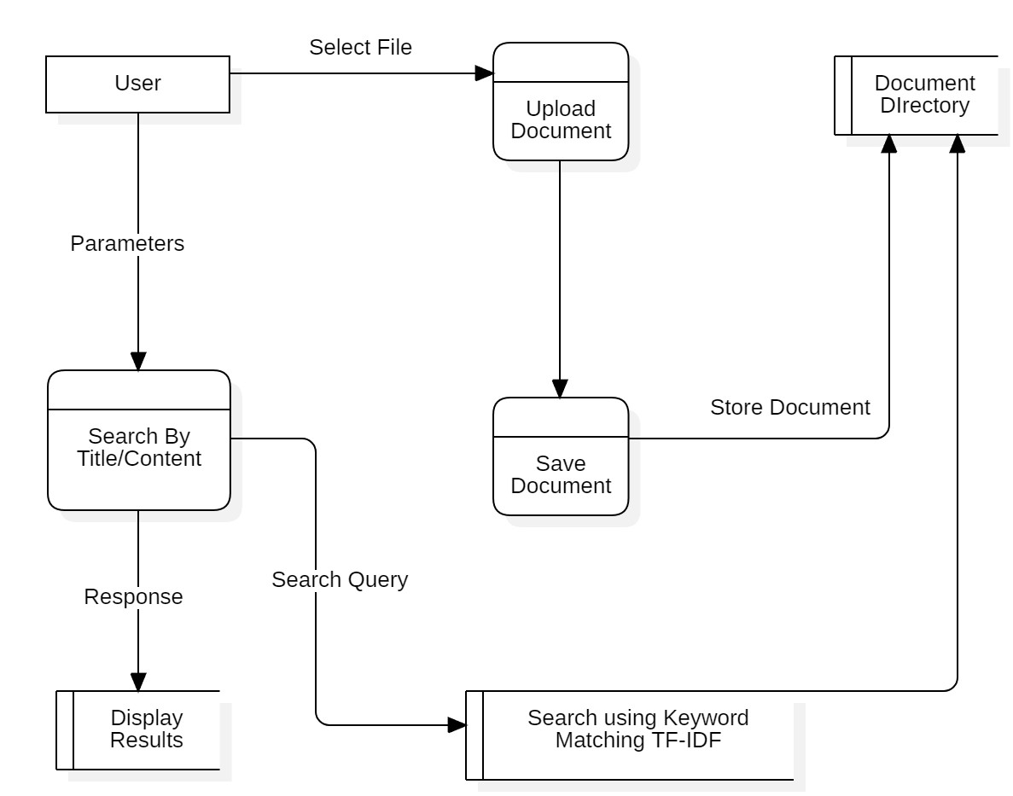
DFD

Slide 14
DFD Explanation
Upload Document: Stores files in the Document Directory.
Search By Title/Content: Locates documents based on search queries.
Indexing: Ensures accurate search results using indexed documents.
Display Results: Shows ranked search results.

Slide 15
Future Enhancements
Add support for multiple document formats (PDF, Word, etc.)
Integrate NLP and semantic search capabilities
Optimize search algorithms for better accuracy

Slide 16
Thank You
Questions and Discussions Welcome!

